Slide 1
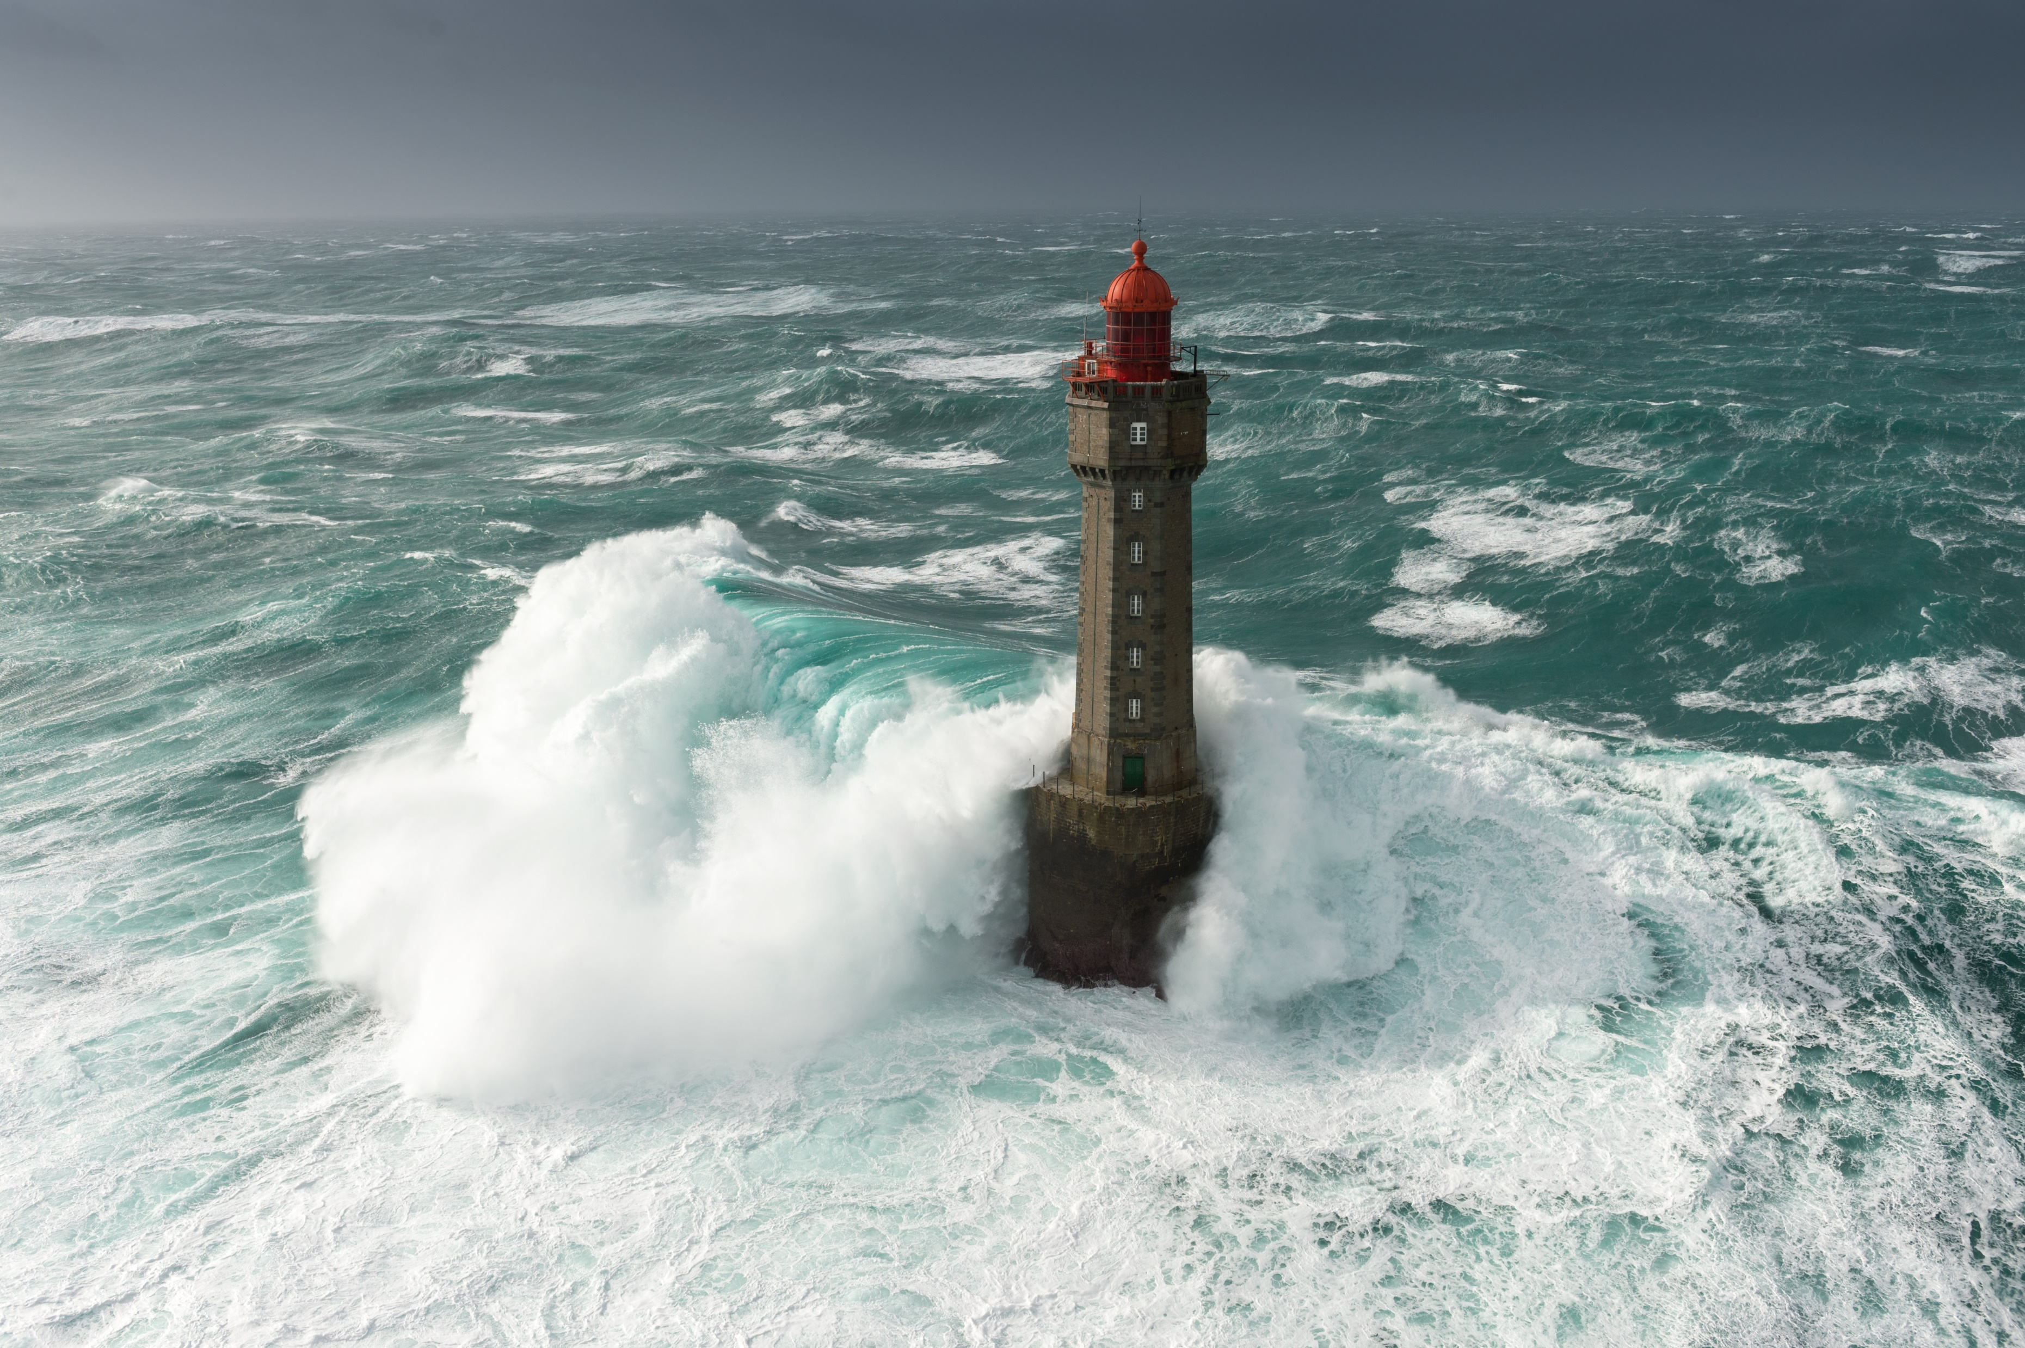
Sea Level Rise Analysis
By: ChaceDaskalos, Swati Goyal, Andrew Hoeppner

Slide 2

Questions we would like to answer
With our research we want to predict if the sea level and temperature continuous to rise every year, how our planet will look in the future.

Slide 3
Machine Learning Model
In our machine learning model we took into account many factors, such as:
Sea Level VS World Population
Sea Level VS Global Temperature
Sea Level VS Antarctica Ice Mass Change
Sea Level VS Greenland Ice Mass Change
Sea Level VS Global CO2 Emissions
Sea Level VS Global Sea Surface Temperature

Slide 4
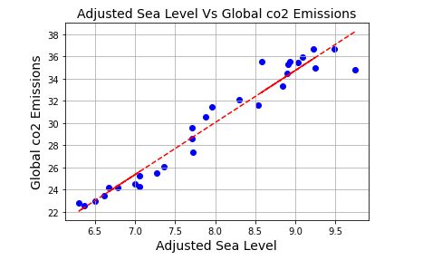
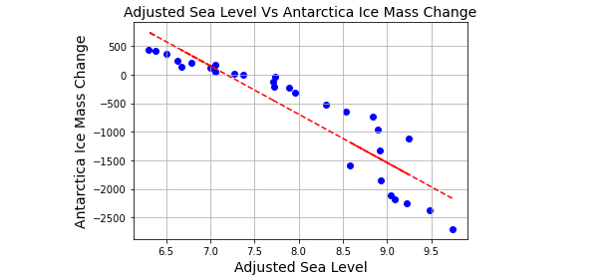
Linear Regression Model

Slide 5
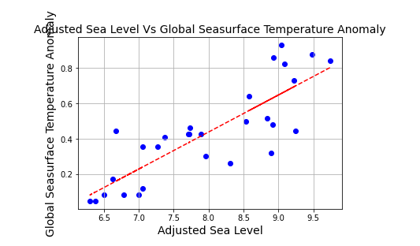
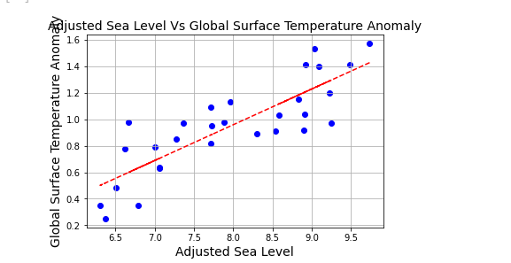
Linear Regression on Sea Level vs Global Seasurface Temperature Anomaly and Global Surface Temperature Anomaly

Slide 6
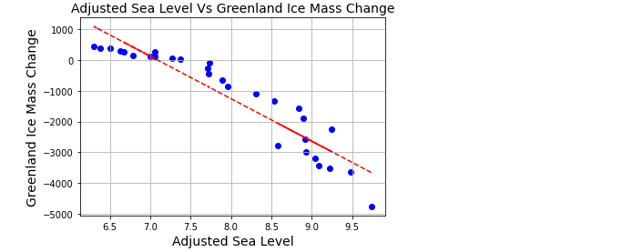
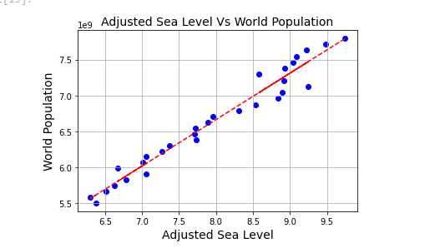
Linear Regression on Sea Level vs World Population and Greenland Ice Mass Change

Slide 7
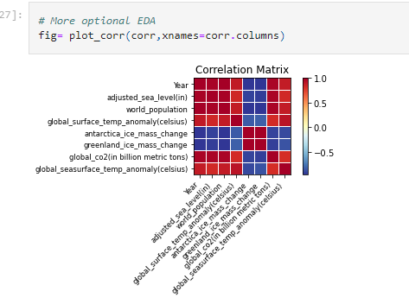
Correlation Matrix

Slide 8

Dashboard Visualization

Slide 9
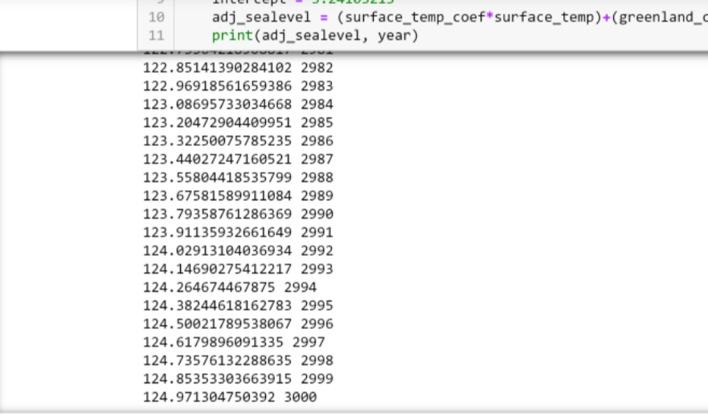
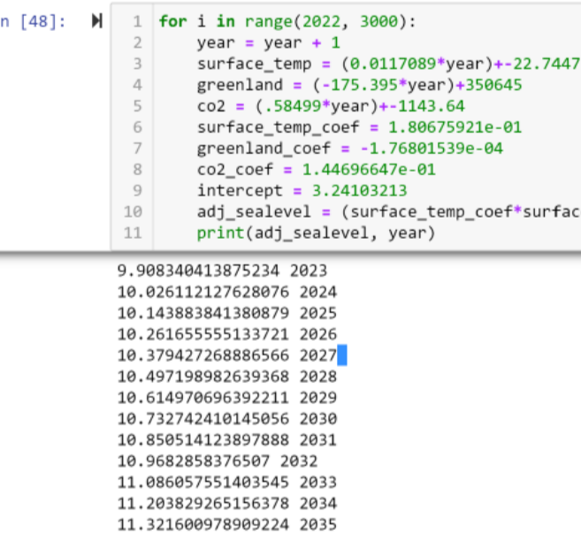
Prediction Year (2023-3000)

Slide 10
Conclusion

Slide 11

Thank You !!
Any Questions??

